Slide 1
Button Input: On/off state change
Living with the Lab
Gerald Recktenwald
Portland State University
gerry@pdx.edu

Slide 2
User input features of the fan
Potentiometer for speed control
Continually variable input makes sense for speed control
Previously discussed
Start/stop
Could use a conventional power switch
Push button (momentary) switch
Lock or limit rotation angle
Button click to hold/release fan in one position
Potentiometer to set range limit

Slide 3
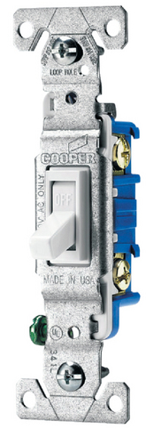
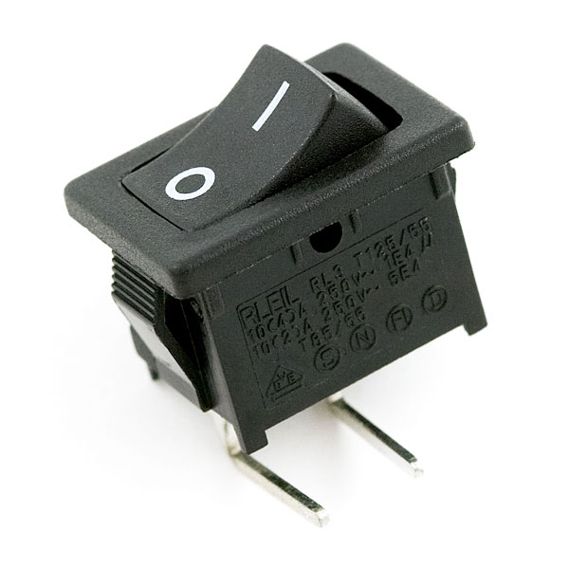
Conventional on/off switch
Basic light switch or rocker switch
Makes or breaks connection to power
Switch stays in position: On or Off
Toggle position indicates the state
NOT in the Arduino Inventors Kit
Image from sparkfun.com
Image from lowes.com

Slide 4
How does a button work?
Simple switch schematic
Use DMM to measure open/closed circuit
Map the pin states

Slide 5
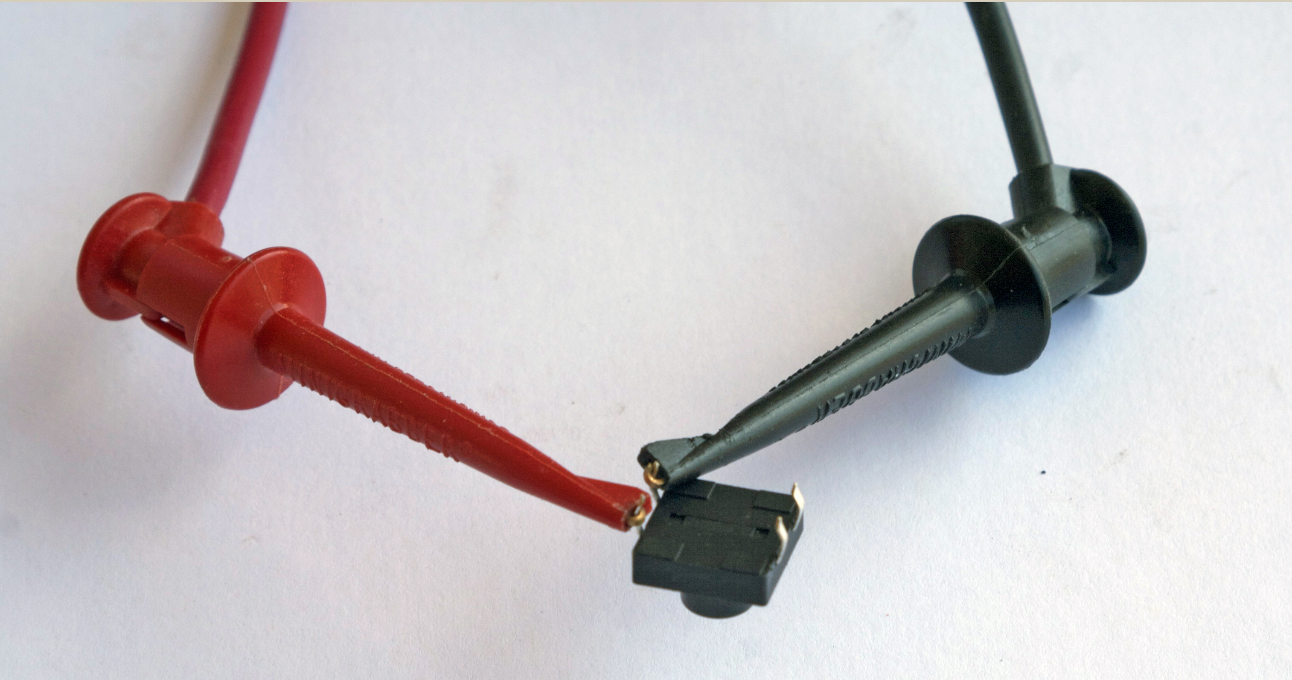

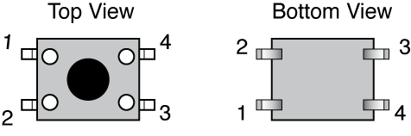
Measure Open and Closed Circuits
 | Measured Resistance (Ω)
Connect Pins | When not pressed | When pressed
1 and 2
1 and 3
1 and 4
2 and 3

Slide 6
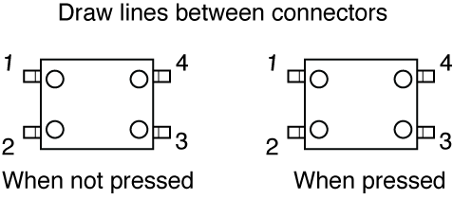
Measure Open and Closed Circuits
Data from Measurements:
Sketch Connections:
 | Measured Resistance (Ω)
Connect Pins | When not pressed | When pressed
1 and 2
1 and 3
1 and 4
2 and 3

Slide 7
Push Button Switches
A momentary button is a “Biased Switch”
Pushing the button changes state
State is reversed (return to biased position) when button is released
Two types
NO: normally open
NC: normally closed

Slide 8
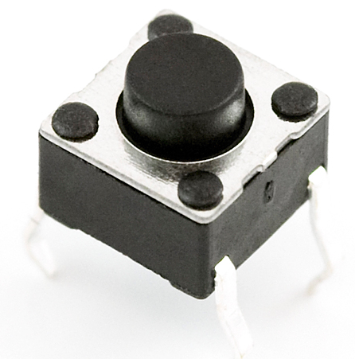
Momentary or push-button switches
Normally open
electrical contact is made when button is pressed
Normally closed
electrical contact is broken when button is pressed
Internal spring returns button to its un-pressed state
Image from sparkfun.com

Slide 9
Putting buttons into action
Build the circuit: same one is used for all examples
Test with LED on/off
LED is only controlled by the button, not by Arduino code
Create a “wait to start” button
Simplest button implementation
Execution is blocked while waiting for a button click
Use an interrupt handler
Most sophisticated: Don’t block execution while waiting for button input
Most sophisticated: Requires good understanding of coding
Requires “de-bouncing”
Not too hard to use as a black box

Slide 10
Momentary Button and LED Circuit
Digital input with a pull-down resistor
When switch is open (button not pressed):
Digital input pin is tied to ground
No current flows, so there is no voltage difference from input pin to ground
Reading on digital input is LOW
When switch is closed (button is pressed):
Current flows from 5V to ground, causing LED to light up.
The 10k resistor limits the current draw by the input pin.
The 330Ω resistor causes a large voltage drop between 5V and ground, which causes the digital input pin to be closer to 5V.
Reading on digital input is HIGH

Slide 11
Technical Note
Usually we do not include an LED directly in the button circuit. The following diagrams show plan button circuits with pull-up and pull-down resistors. In these applications, the pull-up or pull-down resistors should be 10k. Refer to Lady Ada Tutorial #5:
http://www.ladyada.net/learn/arduino/lesson5.html
Pull-up
resistor:
Pull-down
resistor:

Slide 12
Programs for the LED/Button Circuit
Continuous monitor of button state
Program is completely occupied by monitoring the button
Used as a demonstration — not practically useful
Wait for button input
Interrupt Handler
All three programs use the same electrical circuit

Slide 13
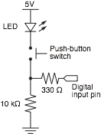
Continuous monitor of button state
int button_pin = 4; // pin used to read the button
void setup() {
pinMode( button_pin, INPUT);
Serial.begin(9600); // Button state is sent to host
}
void loop() {
int button;
button = digitalRead( button_pin );
if ( button == HIGH ) {
Serial.println("on");
} else {
Serial.println("off");
}
}
Serial monitor shows a continuous stream of “on” or “off”
This program does not control the LED

Slide 14
Programs for the LED/Button Circuit
Continuous monitor of button state
Program is completely occupied by monitoring the button
Used as a demonstration — not practically useful
Wait for button input
Blocks execution while waiting
May be useful as a start button
Interrupt Handler
All three programs use the same electrical circuit

Slide 15
Wait for button input
int button_pin = 4; // pin used to read the button
void setup() {
int start_click = LOW; // Initial state: no click yet
pinMode( button_pin, INPUT);
Serial.begin(9600);
while ( !start_click ) {
start_click = digitalRead( button_pin );
Serial.println("Waiting for button press");
}
}
void loop() {
int button;
button = digitalRead( button_pin );
if ( button == HIGH ) {
Serial.println("on");
} else {
Serial.println("off");
}
}
while loop continues as long as start_click is FALSE
Same loop() function as in the preceding sketch

Slide 16
Programs for the LED/Button Circuit
Continuous monitor of button state
Program is completely occupied by monitoring the button
Used as a demonstration — not practically useful
Wait for button input
Blocks execution while waiting
May be useful as a start button
Interrupt Handler
Most versatile
Does not block execution
Interrupt is used to change a flag that indicates state
Regular code in loop function checks the sate of the flag
All three programs use the same electrical circuit

Slide 17
Interrupt handler for button input
int button_interrupt = 0; // Interrupt 0 is on pin 2 !!
int toggle_on = false; // Button click switches state
void setup() {
Serial.begin(9600);
attachInterrupt( button_interrupt, handle_click, RISING); // Register handler
}
void loop() {
if ( toggle_on ) {
Serial.println("on");
} else {
Serial.println("off");
}
}
void handle_click() {
static unsigned long last_interrupt_time = 0; // Zero only at start
unsigned long interrupt_time = millis(); // Read the clock
if ( interrupt_time - last_interrupt_time > 200 ) { // Ignore when < 200 msec
toggle_on = !toggle_on;
}
last_interrupt_time = interrupt_time;
}

Slide 18
Interrupt handler for button input
int button_interrupt = 0; // Interrupt 0 is on pin 2 !!
int toggle_on = false; // Button click switches state
void setup() {
Serial.begin(9600);
attachInterrupt( button_interrupt, handle_click, RISING); // Register handler
}
void loop() {
if ( toggle_on ) {
Serial.println("on");
} else {
Serial.println("off");
}
}
void handle_click() {
static unsigned long last_interrupt_time = 0; // Zero only at start
unsigned long interrupt_time = millis(); // Read the clock
if ( interrupt_time - last_interrupt_time > 200 ) { // Ignore when < 200 msec
toggle_on = !toggle_on;
}
last_interrupt_time = interrupt_time;
}
Interrupt handler must be registered when program starts
button_interrupt is the ID or number of the interrupt. It must be 0 or 1
A RISING interrupt occurs when the pin changes from LOW to HIGH
The interrupt handler, handle_click, is a user-written function that is called when an interrupt is detected

Slide 19
Interrupt handler for button input
int button_interrupt = 0; // Interrupt 0 is on pin 2 !!
int toggle_on = false; // Button click switches state
void setup() {
Serial.begin(9600);
attachInterrupt( button_interrupt, handle_click, RISING); // Register handler
}
void loop() {
if ( toggle_on ) {
Serial.println("on");
} else {
Serial.println("off");
}
}
void handle_click() {
static unsigned long last_interrupt_time = 0; // Zero only at start
unsigned long interrupt_time = millis(); // Read the clock
if ( interrupt_time - last_interrupt_time > 200 ) { // Ignore when < 200 msec
toggle_on = !toggle_on;
}
last_interrupt_time = interrupt_time;
}
toggle_on is a global variable that remembers the “state”. It is either true or false (1 or 0).
The loop() function only checks the state of toggle_on. The value of toggle_on is set in the interrupt handler, handle_click.
The value of toggle_on is flipped only when a true interrupt even occurs. De-bouncing is described in the next slide.

Slide 20
Interrupt handler for button input
int button_interrupt = 0; // Interrupt 0 is on pin 2 !!
int toggle_on = false; // Button click switches state
void setup() {
Serial.begin(9600);
attachInterrupt( button_interrupt, handle_click, RISING); // Register handler
}
void loop() {
if ( toggle_on ) {
Serial.println("on");
} else {
Serial.println("off");
}
}
void handle_click() {
static unsigned long last_interrupt_time = 0; // Zero only at start
unsigned long interrupt_time = millis(); // Read the clock
if ( interrupt_time - last_interrupt_time > 200 ) { // Ignore when < 200 msec
toggle_on = !toggle_on;
}
last_interrupt_time = interrupt_time;
}
Value of a static variable is always retained
Use long: the time value in milliseconds can become large
Clock time when current interrupt occurs
Ignore events that occur in less than 200 msec from each other. These are likely to be mechanical bounces.
Save current time as the new “last” time

Slide 21
Other references
Ladyada tutorial
Excellent and detailed
http://www.ladyada.net/learn/arduino/lesson5.html
Arduino reference
Minimal explanation
http://www.arduino.cc/en/Tutorial/Button
Using interrupts
http://www.uchobby.com/index.php/2007/11/24/arduino-interrupts/
http://www.arduino.cc/en/Reference/AttachInterrupt

