Slide 1
Basic DC Motor Circuits
Living with the Lab
Gerald Recktenwald
Portland State University
gerry@pdx.edu

Slide 2
DC Motor Learning Objectives
Explain the role of a snubber diode
Describe how PWM controls DC motor speed
Implement a transistor circuit and Arduino program for PWM control of the DC motor
Use a potentiometer as input to a program that controls fan speed

Slide 3
What is a snubber diode
and why should I care?

Slide 4
Simplest DC Motor Circuit
Connect the motor to a DC power supply
Switch open
Switch closed

Slide 5
Current continues after switch is opened
Opening the switch does not immediately stop current in the motor windings.

Slide 6
Reverse current
Charge build-up can cause damage

Slide 7
Motor Model
Simple model of a DC motor:
  Windings have inductance and resistance
  Inductor stores electrical energy in the windings
  We need to provide a way to safely dissipate electrical energy when the switch is opened

Slide 8
Flyback diode or snubber diode
Adding a diode in parallel with the motor provides a path for dissipation of stored energy when the switch is opened

Slide 9
Pulse-width modulation (PWM)
for DC motor speed control

Slide 10
Controlling DC Motor Speed
The voltage supplied to a DC motor controls its speed
Arduino cannot supply variable DC output
  Arduino lacks a true analog output
  Use Pulse-width modulation (PWM) to simulate a variable DC supply voltage
  PWM is a common technique for supplying variable power levels to “slow” electrical devices such as resistive loads, LEDs, and DC motors
  Arduino Uno has 6 PWM pins: Digital I/O pins 3, 5, 6, 9,10, and 11

Slide 11
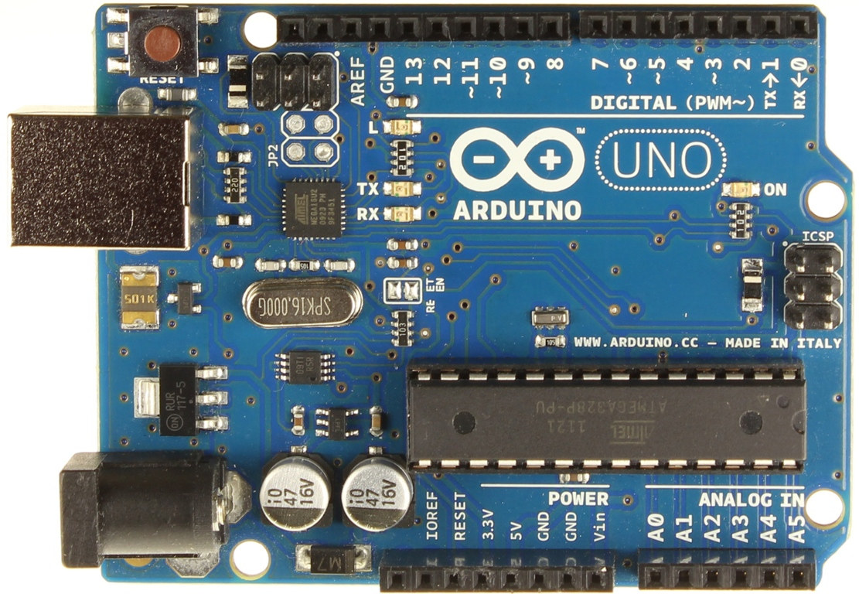
Arduno Uno has 6 PWM pins
Look for the ~ prefix on the digital pin label, e.g. ~3

Slide 12


PWM: Pulsed with modulation
PWM simulates DC voltage control for slow loads
The effective voltage is
is called the duty cycle

Slide 13
Arduino PWM commands
Configure the output pin:
Set the duty cycle
The duty cycle is an 8 bit value:
0 ≤ duty_cycle ≤255
PWM_pin = ... ; // one of 3, 5, 6, 9, 10, 11
void setup() {
pinMode( PWM_pin, OUTPUT);
}
void loop() {
int duty_cycle = 150; // between 0 and 255
analogWrite( PWM_pin, duty_cycle );
}

Slide 14
Using a transistor to switch the load

Slide 15
Transistor as the switching device
Each Arduino output channels has a 40 mA limit
The maximum current draw for an Arduino is 200 mA
Use Arduino as the brain
Let another switching element be the brawn

Slide 16

Use an NPN Transistor as a switch
This device is designed for use as a medium power amplifier and switch requiring collector currents up to 500 mA

Slide 17
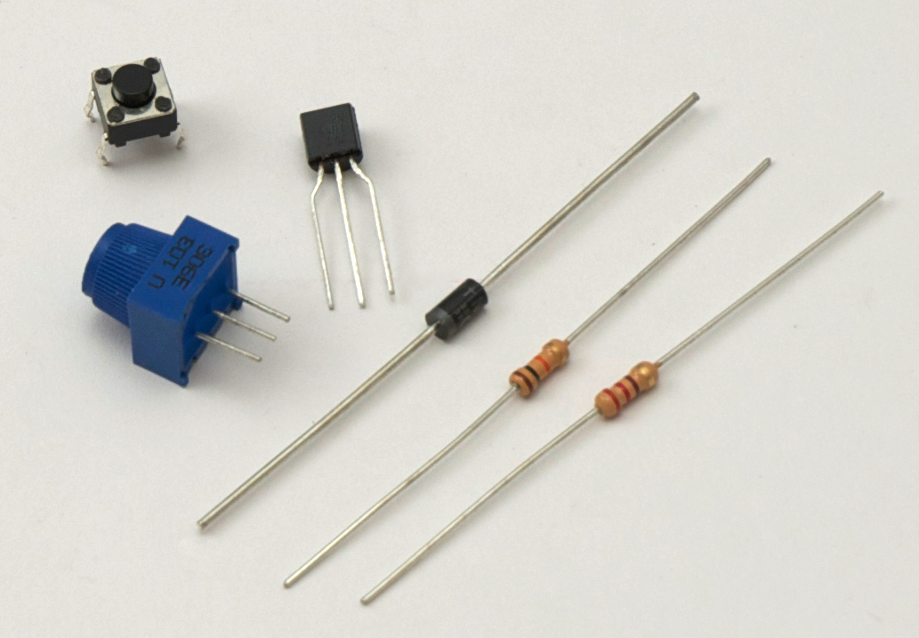
Electronic components in the fan kit
Transistor
Diode
220 Ω or 330 Ω
resistor

Slide 18
Replace the Switch with a Transistor
A transistor allows on/off control to be automated and it allows switching of more current than an Arduino digital pin can supply.
Pin 9 or another PWM pin drives the transistor base

Slide 19
Alternative locations for the transistor
Moving the transistor (and any switch) between the power supply and the motor adds a bit of safety by tying the motor to ground when the system is idle

Slide 20
Diode and transistor orientation

Slide 21
Arduno Uno has 5 PWM pins
Look for the ~ prefix on the digital pin label, e.g. ~3

Slide 22
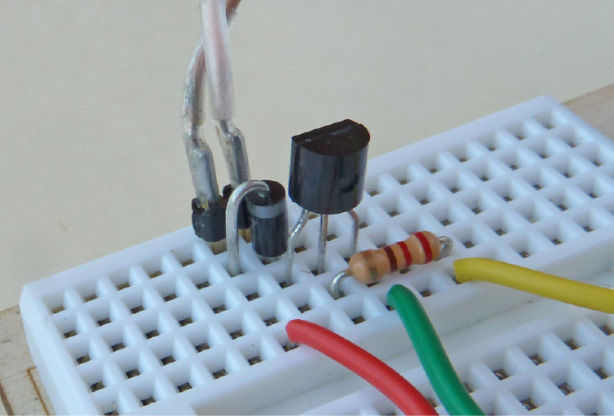
DC Motor Circuit on tiny breadboard

Slide 23
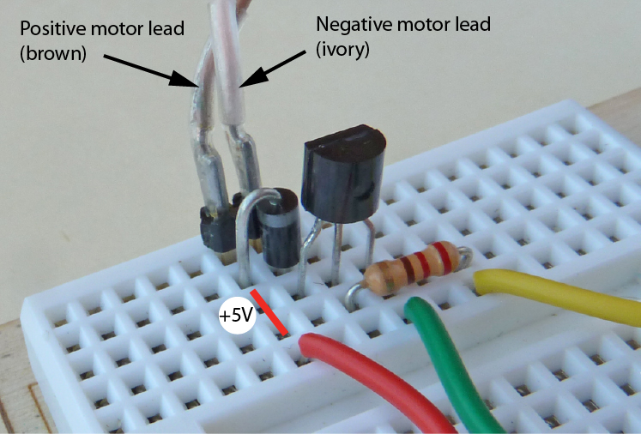
+5V connections

Slide 24
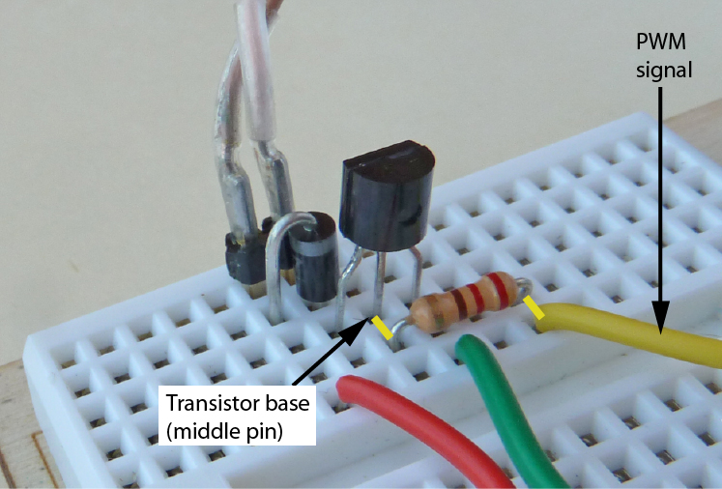
PWM signal is connected to transistor base

Slide 25
Arduino program to spin the DC Motor
Code is in spin_DC_motor.ino
// spin_DC_motor.ino Use PWM to control DC motor speed
int motorPin = 3; // Pin 3 has PWM, connected it to the DC motor
void setup() {
pinMode(motorPin, OUTPUT); // Set motor pin to output mode
}
void loop() {
analogWrite(motorPin, 150); // Motor at 150/255 of full speed
delay(1000);
analogWrite(motorPin, 250); // Motor at 250/255 of full speed
delay(1000);
}

Slide 26
User input to control fan speed

Slide 27
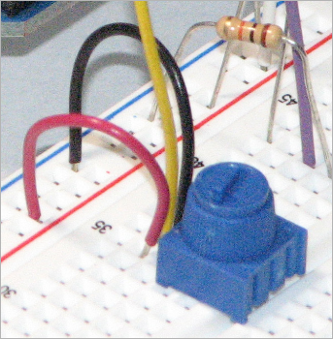
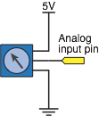
Adjust fan speed with potentiometer input
Use the potentiometer circuit from the earlier analog input exercise

Slide 28
Adjust fan speed with potentiometer input
Code is in DC_motor_speed_control.ino
// File: DC_motor_speed_control.pde
//
// Use potentiometer input to set the speed of a DC motor
// Output to the motor is PWM
int motorPin = 3; // pin connected to the DC motor
int potPin = 1; // analog input connected to the potentiometer
void setup()
{
pinMode(motorPin, OUTPUT);
}
void loop()
{
int PWMoutput, potReading;
potReading = analogRead(potPin);
PWMoutput = map(potReading, 0, 1023, 0, 255 );
analogWrite(motorPin, PWMoutput);
}

Slide 29
Adjust fan speed with potentiometer input
void loop() {
int PWMoutput, potReading;
potReading = analogRead(potPin);
PWMoutput = map(potReading, 0, 1023, 0, 255 );
analogWrite(motorPin, PWMoutput);
}
Each time through the loop:
  Read the voltage at the potentiometer wiper
    Input value is a 10-bit integer: 0 ≤ potReading ≤ 1023
  Scale the 10-bit value (max 1023) to an 8-bit value (max 255)
    PWMoutput = map( potReading, 0, 1023, 0, 255 );
  Update the PWM signal
    analogWrite(motorPin, PWMoutput);
range for
potReading
range for
PWMoutput

