Slide 1
Desktop Fan Project
Introduction
Living with the Lab
Desktop fan workshop
ASEE 2012 Conference

Slide 2
Learning Objectives
Primary Learning Objectives
  Assemble circuits to drive a small DC motor and a servo motor
  Control the DC motor speed with PWM
  Sweep the servo back and forth
  Control the motor speed with a potentiometer
Bonus Objective
  Toggle the motor on and off with a momentary button

Slide 3
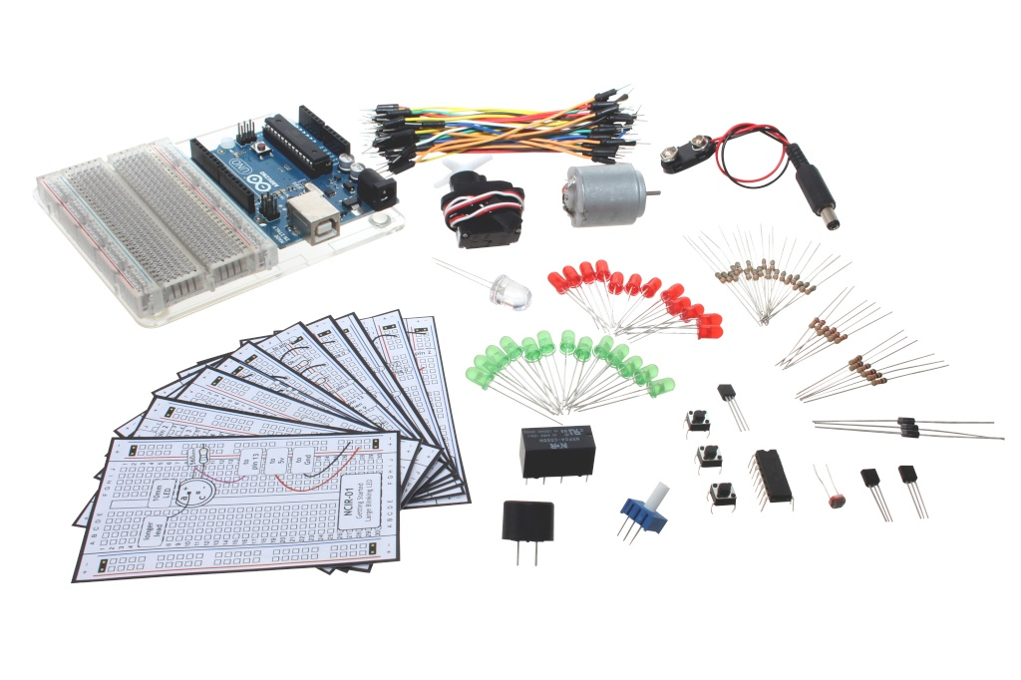
What can you do with this?
Oomlout Starter Kit for Arduino
http://oomlout.co.uk/arduino-starter-kit-ardx-p-183.html

Slide 4
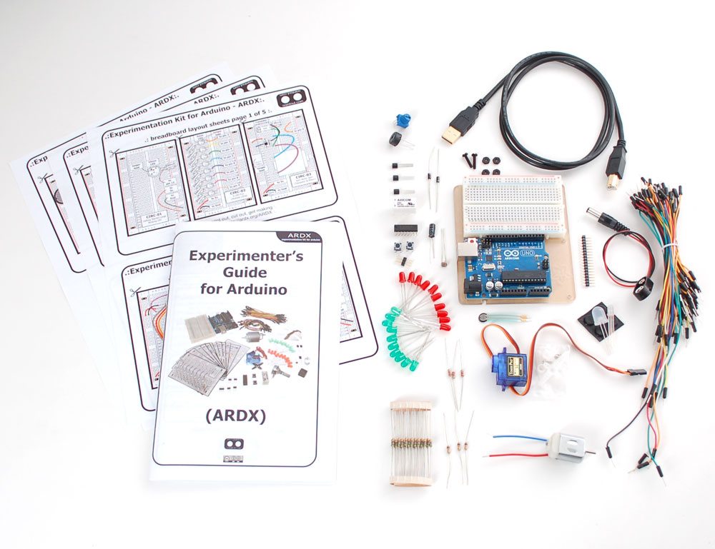
What can you do with this?
Adafruit Experimentation Kit for Arduino
http://www.adafruit.com/products/170

Slide 5
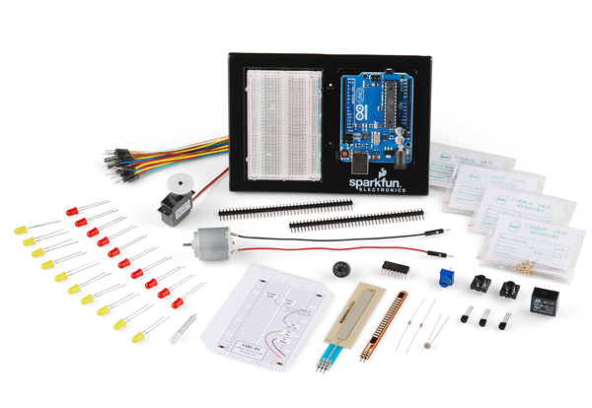
What can you do with this?
Sparkfun Inventor’s Kit for Arduino
http://www.sparkfun.com/products/10173

Slide 6
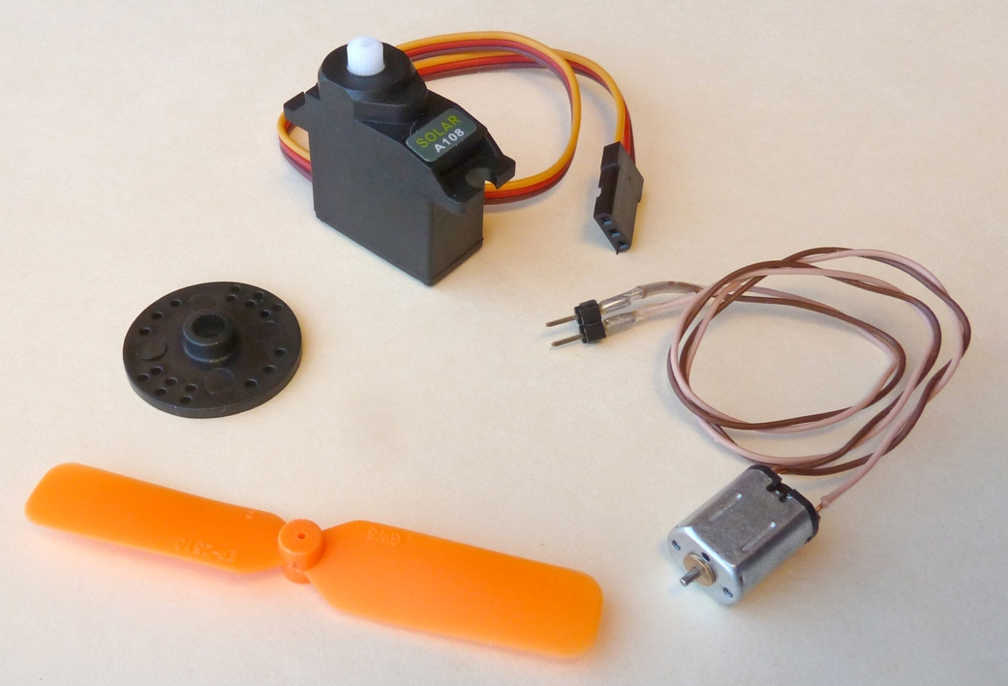
Make an oscillating fan from these parts

Slide 7
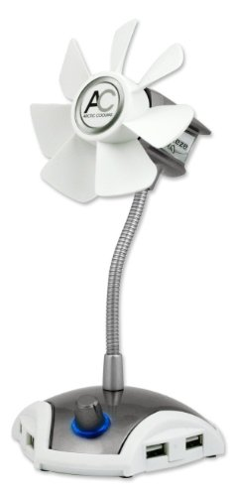
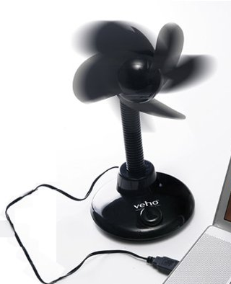
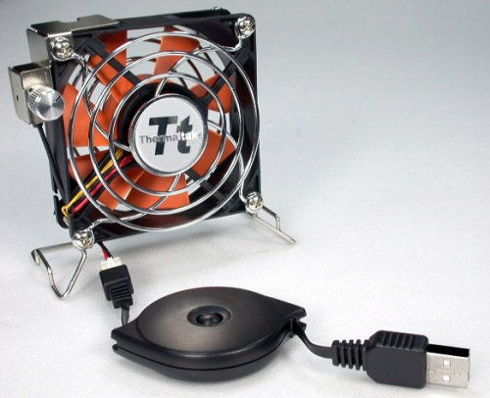
Project for students
Design and build a fan to satisfy these objectives
  A desktop toy for promoting my company
  Air flow direction oscillates
  Fan has on-off button
  Fan speed is variable
  Be creative: I want to like this fan!

Slide 8
“Pull” model of project based instruction
Show the students an answer
  Students need to learn skills to imitate the “answer”
  Most students don’t want to imitate the design
  Several aspects of the structure are left unspecified

Slide 9
“Pull” model of project based instruction
Show the students an answer
  Students need to learn skills to imitate the “answer”
  Most students don’t want to imitate the design
  Several aspects of the structure are left unspecified
To complete the project students must
  Learn how to use Solidworks (or similar tool) to draw the structure
  Measure parts in order to make the structure fit
  Learn how to write loops and other programming structures
  Learn how to debug, because it doesn’t work the first time
  Learn how to make a presentation to explain their design to the rest of the class
  Work on a team, because there is too much work for one person

Slide 10
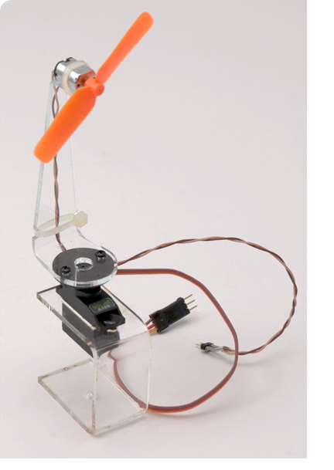
DC Fan Assembly
Assembled for workshop participants
  Laser cut acrylic base and fan strut
  Extension leads on DC motor
  DC motor secured with zip ties
  Servo mounted with snap rivets
  Strut screwed to the servo horn

Slide 11
Focus on wiring and programming
Today we will focus on
  Getting the DC motor circuit working
  Connecting the Servo
  Playing with loops and delays to control sweep speed
  Connecting a potentiometer to control fan speed
  Connecting a button or switch to toggle the fan on and off

